Slide 1
Blackpool Council Analysis Report Overview of the employment landscape and opportunities for Fedcap Employment
Oluwatosin Akindolie
Jan 2025
19/01/2025

Slide 2
Report Overview
Blackpool has one of the highest unemployment rates in the UK, with around 8.6% of the working-age population unemployed, compared to the national average of 4.3%. This, combined with a high level of economic inactivity, has had a significant impact on the local economy in terms of increased dependency on benefits, lower workforce and many more.
Objective
Using employment data from ONS, this report aims to identify;
The key employment challenges facing Blackpool, including high unemployment (8.6%) and economic inactivity.
The factors contributing to skills gaps and limited access to long-term career opportunities.
Potential opportunities for Fedcap Employment

Slide 3
Key Insights
Blackpool’s unemployment rate is higher than the national average, especially among youth leading to more reliance on allowance claim.
Blackpool's economic inactivity rate (31.6%) is higher than both the Northwest (23.7%) and England (21.3%) averages, suggesting a greater proportion of the population is not engaged in work or actively seeking employment. Key reasons for economic inactivity include retirement, long-term sickness/disability, and caregiving responsibilities.
Youth employment challenges are evident in Blackpool, with a 12.8% NEET rate, 14.2% youth unemployment, and only 38.4% in full-time education, pointing to opportunities for targeted support and engagement.

Slide 4
Opportunities for Fedcap Employment
Opportunity to Secure Funding
Fedcap Employment can leverage funding opportunities for schemes targeting youth employment, especially those aged 18–25, by collaborating with Blackpool Council.
Targeted Skills Development
With a significant proportion of Blackpool residents holding only basic qualifications, there is a strong opportunity for Fedcap Employment to offer tailored skills development and training programmes to improve employability.
Expansion of the Restart Scheme
Blackpool's youth unemployment rate of 14.2% highlights a clear opportunity for Fedcap Employment to expand its Restart Scheme, addressing the specific needs of young jobseekers.
Support for Vulnerable Groups
Many Blackpool residents face barriers to work due to long-term health conditions or caregiving responsibilities. Opportunity for Fedcap Employment (Work and Health programme) or developing specialised programmes to support these groups by promoting flexible roles, workplace adjustments, and confidence-building initiatives.

Slide 5
ANALYSIS

Slide 6
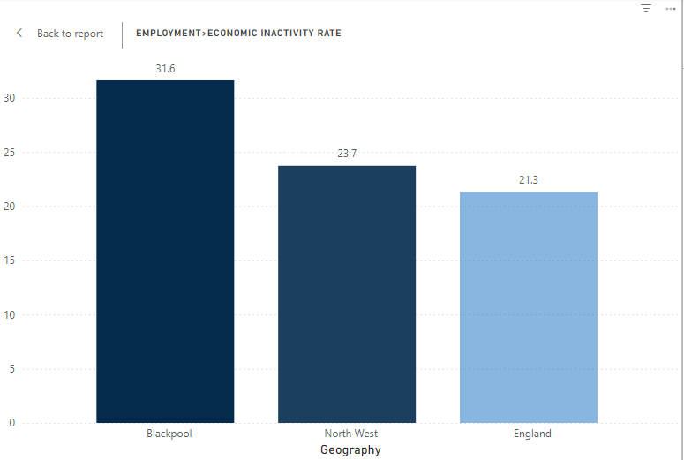
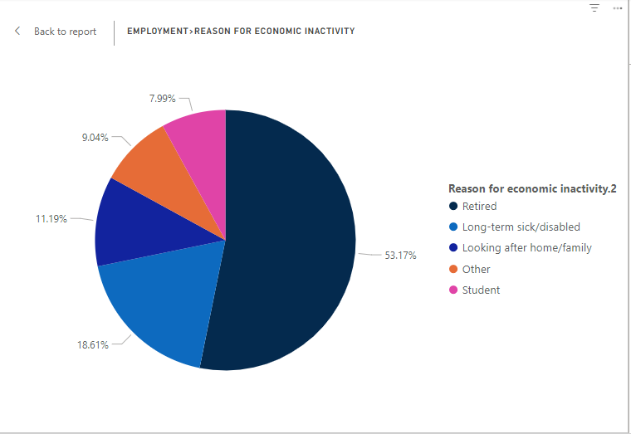
Blackpool faces a significant rate of economic inactivity, which is notably high compared to national averages. The key contributors to this inactivity are retirement and long-term disability, which limit the number of working-age individuals actively participating in the labour market.
Economic Inactivity Rate
Reasons for Inactivity

Slide 7
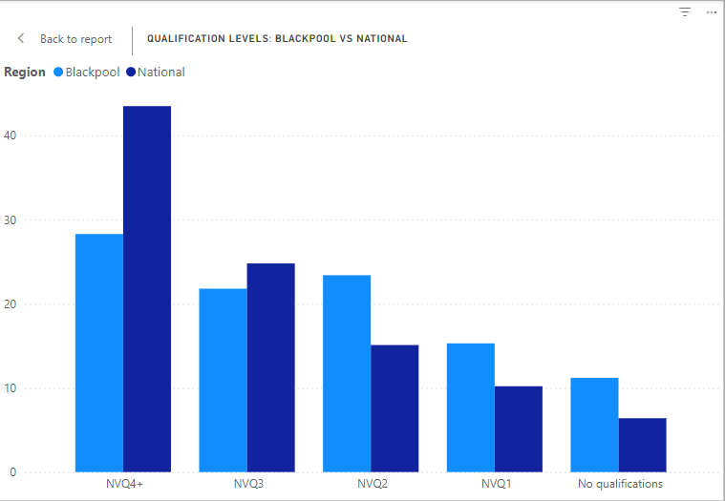
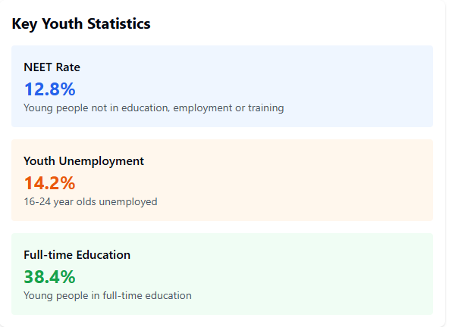
Youth employment challenges are evident in Blackpool, with a 12.8% NEET rate, 14.2% youth unemployment, and only 38.4% in full-time education, pointing to opportunities for targeted support and engagement.
Qualification Levels
Youth Statistics

Slide 8
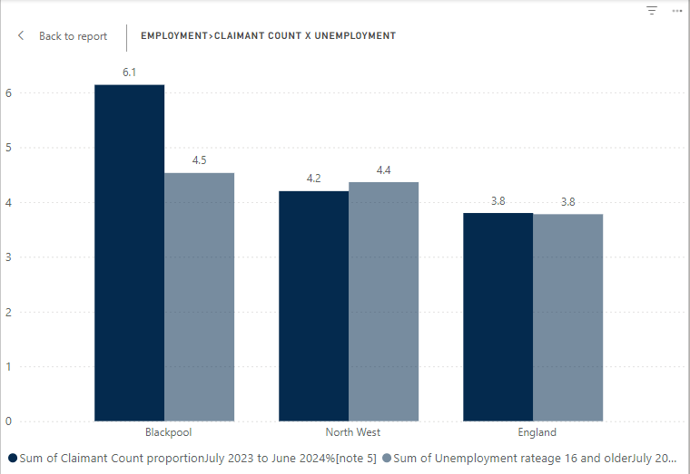
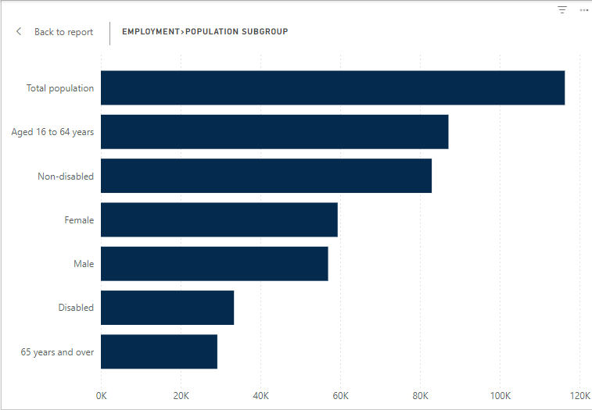
Blackpool’s unemployment rate is higher than the national average, especially among youth leading to more reliance on allowance claim.
Unemployment & Claimant Rate
Population Subgroup

Slide 9
QUESTIONS?

Slide 10
THANK YOU

